Slide 1
SQL – Creating Databases
Key Concepts:
Data Types
CHAR, VARCHAR, NCHAR, NVARCHAR, DECIMAL, NUMERIC, MONEY, ….
Data Definition Language (DDL)
CREATE DATABASE
CREATE SCHEMA
CREATE TABLE
Specify attributes, types, are nulls allowed.
PKs & FKs.
Order of CREATE TABLE statements is important if there are foreign key references.
Data Manipulation Language (DML)
INSERT INTO
Constraints

Slide 2
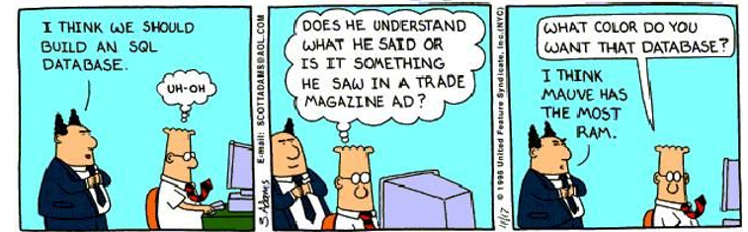

Slide 3
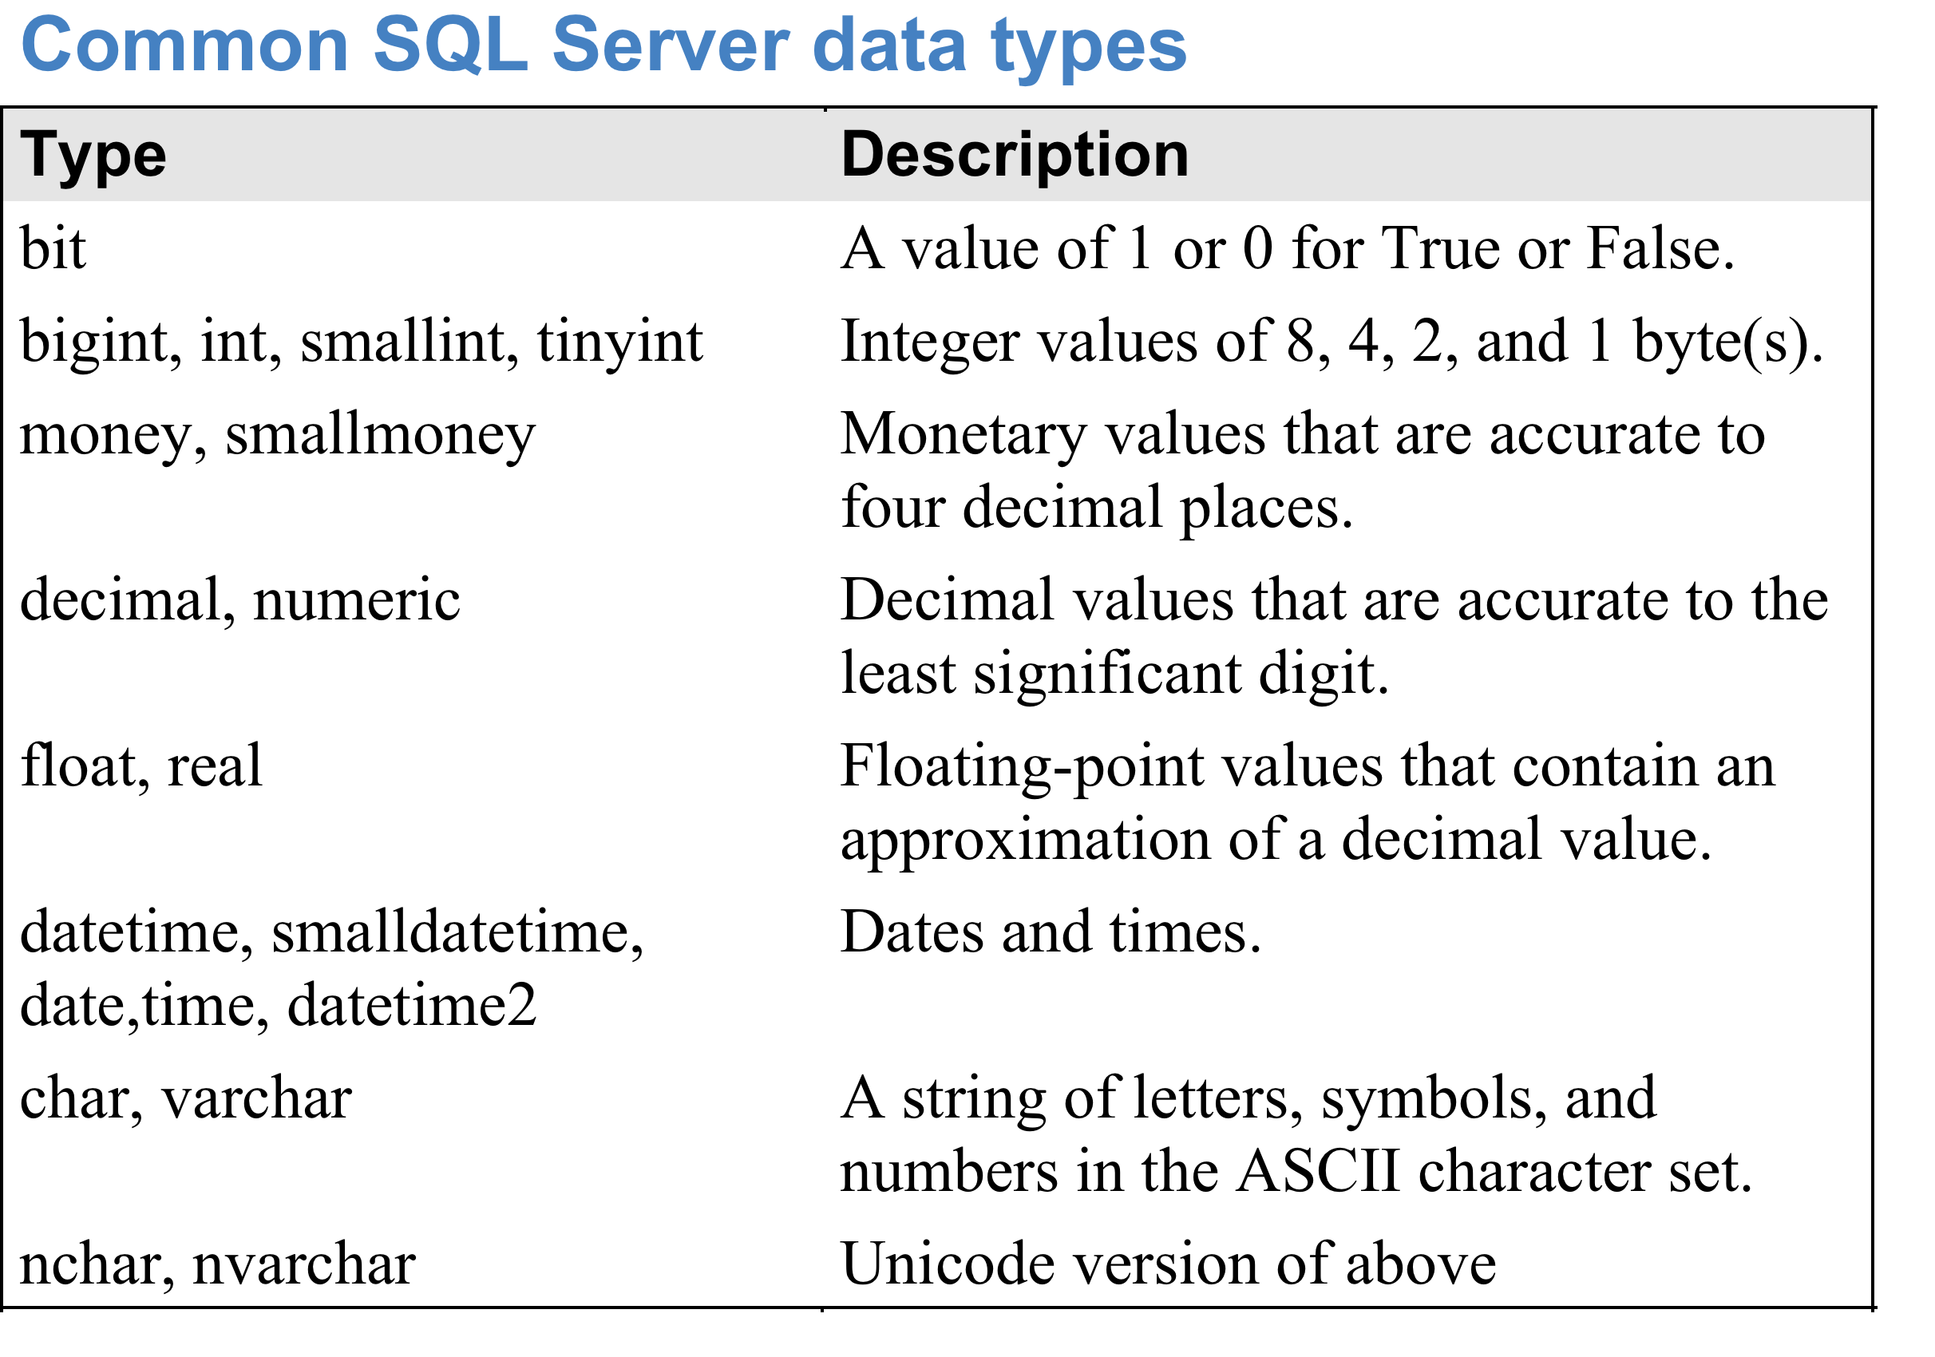
SQL Server Architecture
NOTE: With NUMERIC, specify both the total number of places and the number of places
after the decimal point; e.g NUMERIC(5,2). Omitting these can cause problems.
Full list of data types is at
http://technet.microsoft.com/en-us/library/ms190309.aspx

Slide 4
Data Type Precedence
If data of 2 different types occurs in an expression, data of lower type precedence is automatically converted to the higher type precedence.
From highest to lowest:
Dates Float Real Decimal Numeric Int Char
Automatic type-conversion is often convenient.
E.g. dates can be specified as strings.
Automatic type-conversion is often dangerous.
E.g. if a column is specified as INT, you can put a floating point number into it, but the value will be truncated without any message informing you what happened.
The CAST and CONVERT functions can be used to convert explicitly from one data-type to another.

Slide 5
Character Data
Strings are denoted using single quotes.
Double quotes are used for irregular identifier names.
E.g. "name containing spaces".
To get a single quote inside a string, use 2 single quotes.
E.g. 'a quote: '' followed by some text'
SQL Server supports ASCII and Unicode character data types.
ASCII is CHAR and VARCHAR – 1 byte of storage per character.
Supports English & most Western European languages.
Unicode is NCHAR and NVARCHAR – usually 2 bytes of storage per character, sometimes 4 bytes per character.
Supports all languages.
Denoted by an N in front of the string; E.g. N'hello'

Slide 6
CHAR vs VARCHAR
An attribute defined as CHAR or NCHAR is stored in a fixed number of characters specified when it is defined, independent of the actual length of the string.
E.g. CHAR(20) occupies exactly 20 characters.
An attribute defined as VARCHAR or NVARCHAR is stored in as much space as required, up to a maximum specified when it is defined.
E.g. VARCHAR(10) occupies no more than 10 characters.
NOTE: Leaving out the number, by typing VARCHAR(), defaults to 1! Error will occur when string exceeds that.
Can use VARCHAR(MAX) to allow storage up to a certain threshold (8,000 bytes by default) as long as it fits in the row.
VARCHAR and NVARCHAR are:
More efficient than CHAR and NCHAR for reading, because storage is less.
But may be less efficient when writing (e.g. updating data), because the row may have to be expanded.

Slide 7
Decimal, Numeric & Money
Decimal and Numeric are essentially equivalent.
Specify as Decimal(p,s) or Numeric(p,s).
p is precision – the total number of digits.
Default in SQL Server is 18.
s is scale – the number of digits to the right of the decimal point.
Use smallmoney for monetary values < 200,000.
For larger values use money.
Money and smallmoney give 4 decimal places of accuracy.

Slide 8
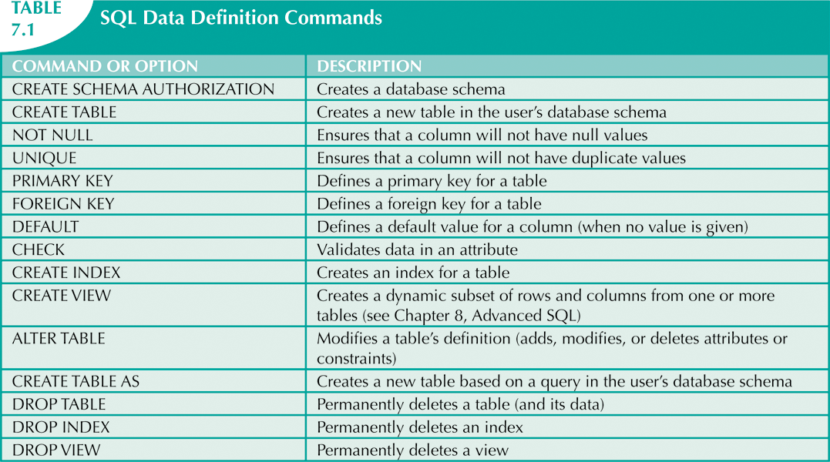
Data Definition Language

Slide 9
Creating Database Tables
Need to:
Create the database.
Create schema(s) (optional).
Create each table.
Table names should always be SINGULAR, since a table denotes an entity.
Insert rows into each table.
If you create the tables and insert the data in the same script, place a GO statement after creating all the tables (before inserting the data).
This makes sure that the previous statements are executed, so that the tables definitely exist before trying to put data into them.

Slide 10
Create Database
In SQL Server Management Studio, a new database can be created either by:
Right-click on "Databases", select New Database, type the name, choose the owner, and click "OK", (NOT "Add");
OR
(2) Executing the command below.
IF DB_ID('database_name') IS NULL
CREATE DATABASE database_name;
When creating a new database always check to see if it exists. Although not true of SQL Server, some RDBMS will delete an existing database if you try to create a new database with the same name.
If the database doesn't appear under "Databases", right click on Databases and select "Refresh".
May also need to go Edit -> Intellisense -> Refresh Local Cache to remove error messages.

Slide 11
Create Schema using GUI
In SQL Server Management Studio, a new schema can be created either through the GUI or using a script.
Creating schema(s) is optional. If no schema is created, SQL Server uses a default schema called "dbo" (database owner).
Using the GUI:
Right-click on the "Security" folder within the database you want to add the table to, and select New -> Schema. Then specify the schema name and owner.

Slide 12
Create Schema using Script
USE database_name;
--Always include the USE statement to define the database context.
GO
IF SCHEMA_ID('schema_name') IS NULL
BEGIN
EXEC ('CREATE SCHEMA schema_name AUTHORIZATION dbo')
END
GO
The GO statements enclose the CREATE SCHEMA statement in its own batch.

Slide 13
Create Table using GUI
In SQL Server Management Studio, a new table can be created either through the GUI or using a script.
Using the GUI:
Right-click on the "Tables" folder within the database you want to add the table to, and select New Table.
For each column:
Type the column name.
Select the column data type from the drop-down.
Check if nulls are allowed in the column.
May need to Refresh the Tables view to see the new table.

Slide 14
Create Table using Script
USE database_name;
--Always include the USE statement to define the database context.
--Test to see if the table exists first.
IF OBJECT_ID('schema_name.Students', 'U') IS NOT NULL
DROP TABLE schema_name.Students;
-- Could instead keep the table if it exists; only create it if doesn't exist.
CREATE TABLE schema_name.Student
(studentid INT NOT NULL,
firstname VARCHAR(30) NOT NULL,
lastname VARCHAR(30) NOT NULL,
major VARCHAR(30) NULL,
PRIMARY KEY(studentid)
);
-- The primary key can contain multiple attributes – separate them with commas.
--'U' stands for User Table – can be omitted.
Put NOT NULL for every
attribute unless you are
really sure that nulls
need to be allowed.
NULL is the default
– undesirable!

Slide 15
Primary Key
SQL does allow a table to be created without a PK. Don't do this!
Primary keys are usually specified in one of two ways:
After all the columns have been listed, add a constraint in the form PRIMARY KEY(column1, column2, …)
When listing a column, specify whether it is the PK (one column only).
E.g. Team_ID INT PRIMARY KEY
Note that NOT NULL can be omitted here, because the PK doesn't allow NULLs.

Slide 16
IDENTITY Columns
A column can be specified as an IDENTITY column in the CREATE TABLE statement.
E.g. studentID INT IDENTITY(2,3)
This causes the columns values to be automatically inserted for each row based on the seed and increment values.
In this example seed is 2 and increment is 3, so the studentID’s of successive rows in the table will be: 2, 5, 8, 11, 14, etc.
The most common values for seed and increment are 1; these are the defaults.
i.e. specifying IDENTITY means the values will be 1,2,3, and so on.
Since SQL Server 2012, there is another way of creating automatic values – SEQUENCE objects. (See CIS 355.)

Slide 17
Where is the Table?
If you execute a script using a CREATE TABLE command successfully, and cannot find the table even after refreshing the database:
Look in the System Databases – it may have been placed there if you forgot to specify the database with a USE statement.
Delete it there;
Put the USE statement into the script;
Create it again and check if it’s in the correct place.

Slide 18
Foreign Keys
Suppose we want an ENROLL table with a foreign key for the studentid's who are enrolled.
IF OBJECT_ID('schema_name.Enroll', 'U') IS NOT NULL
DROP TABLE schema_name.Enroll;
CREATE TABLE schema_name.Enroll
(
classID INT NOT NULL
studentID INT NOT NULL,
studentGrade VARCHAR(20) NOT NULL,
PRIMARY KEY(classID),
FOREIGN KEY(studentID) REFERENCES schema_name.Student
);

Slide 19
Common Error
NOTE: If you have already created a table with a foreign key reference to another table, then you must drop that table first. You cannot drop a table if it referenced by another table that exists.
E.g. the following will NOT work (assuming the 2 tables already exist and ENROLL has a FK referencing Student):
IF OBJECT_ID('schema_name.Student', 'U') IS NOT NULL
DROP TABLE schema_name.Student;
IF OBJECT_ID('schema_name.Enroll', 'U') IS NOT NULL
DROP TABLE schema_name.Enroll;
CREATE TABLE schema_name.Student
…..
The error message is: "Could not drop object 'schema_name.Student' because it is referenced by a FOREIGN KEY constraint."

Slide 20
Order is Important
To fix this, drop the referencing table first.
IF OBJECT_ID('schema_name.Enroll', 'U') IS NOT NULL
DROP TABLE schema_name.Enroll;
IF OBJECT_ID('schema_name.Student', 'U') IS NOT NULL
DROP TABLE schema_name.Student;
CREATE TABLE schema_name.Student …..
CREATE TABLE schema_name.Enroll …..
Inverse order: The last table dropped should be the first table added.

Slide 21
Giving Names to Keys
Instead of just saying PRIMARY KEY(studentid), an alternative syntax allows you to name the key:
CONSTRAINT PK_Students PRIMARY KEY(studentid)
Similarly, for foreign keys, instead of
FOREIGN KEY(studentID) REFERENCES schema_name.Student
you can name the key:
CONSTRAINT FK_Enroll_Student
FOREIGN KEY(studentID) REFERENCES schema_name.Student
Note the convention is for a foreign key name to contain both table names.

Slide 22
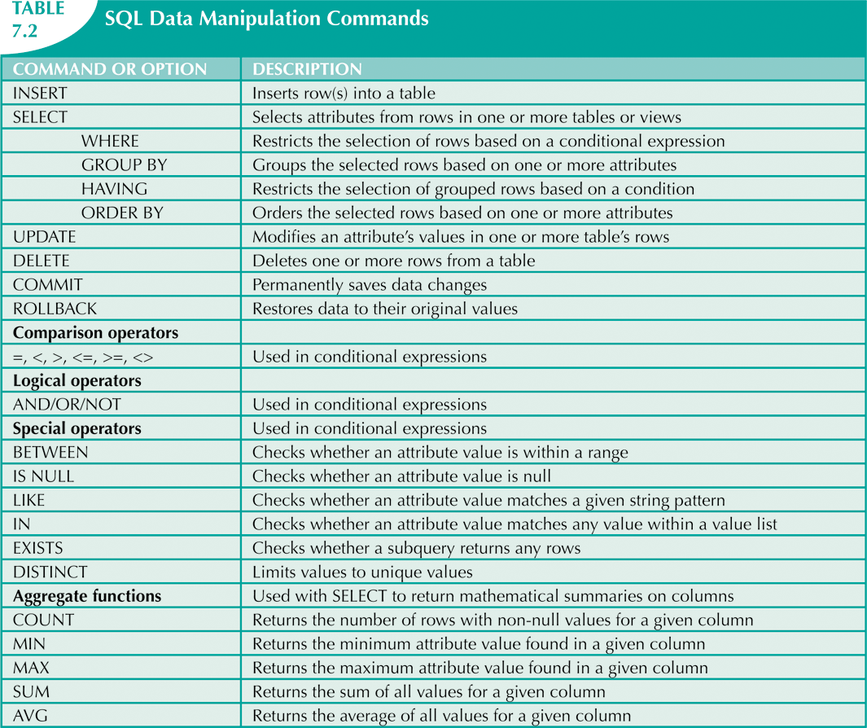
Data Manipulation Language
Note: Inserting rows is a data manipulation function, not a data definition function.

Slide 23
INSERT INTO
INSERT INTO tablename(col1, col2, …)
VALUES(value for col1, value for col2, …)
NOTE: INTO is optional, but is usually included.
Inserts one row into the table specified by tablename.
The column names can be optionally listed after the table name.
The values to insert into each column are listed after the VALUES keyword in the same order as the columns.
If a value is specified for a column it will be used.
If no value is specified for a column and the column names are listed after the table name, a default value will be used, if specified in the CREATE TABLE statement.
If no default exists, NULL will be inserted
If the column doesn't allows NULL, an error occurs.

Slide 24
Inserting Rows - Examples
Column-names not specified:
INSERT INTO dbo.Orders VALUES(10001, ‘2009-02-12’, 3, ‘A’);
All column-names and values specified:
INSERT INTO dbo.Orders(orderid, orderdate, empid, custid) VALUES(10001, ‘2009-02-12’, 3, ‘A’);
Use of default value:
INSERT INTO dbo.Orders(orderid, empid, custid) VALUES(10002, 5, ‘B’);
-- No value specified for orderdate – default will be used.
Missing value without a default, no NULLs allowed.
INSERT INTO dbo.Orders(orderid, empid) VALUES(10003, 4);
-- Error results because custid value is missing and custid is NOT NULL.

Slide 25
Common Insert Error
When inserting data, an error message of the form "….. data will be truncated" usually means you are trying to insert something with too many characters.
E.g. if a column is declared as CHAR(20), inserting something with more than 20 characters will cause this error.

Slide 26
GO
GO is not a SQL statement; it is a Microsoft SQL Server instruction that divides a file of SQL commands into different "batches". Each batch is guaranteed to complete execution before the next one starts.
GO should definitely be used in the following cases. It can be added in other places if needed.
Before and after any CREATE SCHEMA statement.
Between creating the tables and inserting the data.

Slide 27
INSERT SELECT
INSERT INTO … SELECT inserts a set of rows that were returned by a SELECT query.
If values are not specified for all the columns, defaults and NULLs are used in the same way as with INSERT INTO … VALUES.
INSERT SELECT can be used to insert one row at a time.
E.g. Instead of
INSERT INTO dbo.Orders VALUES(10001, ‘2009-02-12’, 3, ‘A’);
do INSERT INTO dbo.Orders SELECT 10001, ‘2009-02-12’, 3, ‘A’;
-- NOTE: no brackets around the values.
INSERT SELECT can insert multiple rows from another table. E.g.
INSERT INTO dbo.Orders(orderid, orderdate, empid, custid)
SELECT orderid, orderdate, empid, custid
FROM TSQL2012.Sales.Orders
WHERE shipcountry = ‘UK’;

Slide 28
Inserting Multiple Rows (T-SQL)
T-SQL allows multiple rows to be inserted at once by putting multiple rows in the VALUES clause.
E.g.
INSERT INTO dbo.Orders(orderid, orderdate, empid, custid)
VALUES
(10003, ’2009-02-13’, 4, ‘B’),
(10004, ‘2009-02-14’, 1, ‘A’),
(10005, ‘2009-02-13’, 1, ‘C’);
NOTE: The statement is atomic - if ANY row fails, NONE of the rows are added.

Slide 29
Inserting Multiple Rows (Standard SQL)
In standard SQL, to insert multiple rows, either:
Use multiple INSERT INTO statements or
Use INSERT SELECT with UNION ALL
E.g.
INSERT INTO dbo.Orders(orderid, orderdate, empid, custid)
SELECT 10003, ’2009-02-13’, 4, ‘B’,
UNION ALL
SELECT 10004, ‘2009-02-14’, 1, ‘A’,
UNION ALL
SELECT 10005, ‘2009-02-13’, 1, ‘C’;

Slide 30
BULK INSERT (T-SQL)
BULK INSERT populates a table with data from a file.
Need to specify:
The target table;
The source file;
Options such as file type, field terminator, and row terminator.
E.g.
BULK INSERT dbo.Orders FROM ‘c:\temp\orders.txt’
WITH (
DATAFILETYPE = ‘char’,
FIELDTERMINATOR = ‘,’,
ROWTERMINATOR = ‘\n’
);

Slide 31
Unique Constraints
Constraints – Attributes can be constrained in various ways.
An attribute or combination of attributes can be constrained to have unique values.
For single attributes this can be done in 2 ways, either when declaring the attribute or in the list of constraints.
E.g.
Team_Name CHAR(20) NOT NULL UNIQUE,
OR
Team_Name CHAR(20) NOT NULL,
………..
PRIMARY KEY(…..),
UNIQUE(Team_Name)
NOTE: The PK is constrained to be unique automatically.

Slide 32
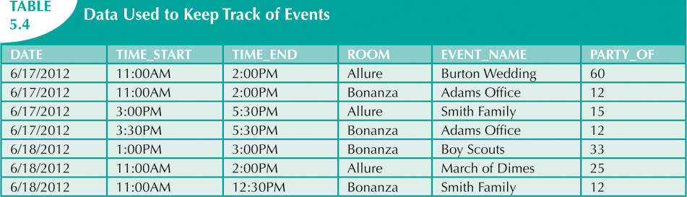
Surrogate Keys and Unique Constraints
In the above table, the combination of DATE, TIME_START, and ROOM must be unique, but this makes an awkward PK.
Could create a surrogate PK by giving each row a unique number. But then need to guarantee uniqueness of the combination date,time,room to PREVENT accidental data duplication.
UNIQUE(DATE, TIME_START, ROOM)

Slide 33
Check Constraints
An attribute's allowed values (or a combination of attributes) can be specified by a check constraint.
E.g.
CHECK(Student_ID > 0)
CHECK(Gender IN ('M', 'F'))
CHECK(Age BETWEEN 0 AND 140)
CHECK(PhoneNumber IS NOT NULL OR CellNumber IS NOT NULL)
CHECK(ZipCode LIKE '[0-9][0-9][0-9][0-9][0-9]')
CHECK(US_PhoneNumber LIKE
'[0-9][0-9][0-9]-[0-9][0-9][0-9]-[0-9][0-9][0-9][0-9]') CHECK(Email LIKE '_%@_%.[a-z][a-z][a-z]%')
Some data-types come with built-in constraints; e.g. a column specified as one of the DATE types cannot have invalid dates placed into it.

Slide 34
Other Types of Constraints
Default values can be specified for attributes.
When inserting a row, attributes that are not specified are given their default values.
You can specify what happens when values in a PK column that are referenced as a FK are updated or deleted.
The default is that an error occurs.
Can specify things like ON DELETE CASCADE, which will cause any referencing rows to be deleted if a referenced value is deleted.

Slide 35
More about Constraints
It is a good idea to name each constraint, so that it can be modified or removed later.
Don't duplicate constraints!
E.g. if column A has a constraint, and column B links to A via a FK, don't add the constraint to column B.
It's unnecessary – it's already constrained.
Changing the constraint will require making multiple changes.
Case-Sensitive constraints:
If the database's setting are that the table contents are not case-sensitive, then constraining an attribute's values to, for example, ('M', 'F') will treat 'm' and 'f' as valid values.
A case sensitive constraint can be specified using the COLLATE clause used for case-sensitive queries.
E.g. CHECK(Gender COLLATE Latin1_General_CS_AS IN ('M', 'F'))

Slide 36
Where to Impose Constraints
Often constraints can be imposed at the application program level, not at the database level.
E.g. if someone is entering information into a web-form, the web-application can check that the information (e.g. address, phone-number, email, etc) is valid, BEFORE it gets inserted into the database.
In this case a database constraint would not be needed.
Would it hurt to have the database constraint as well? Not really, though both the application program and the database would need to be updated if the list of allowed values changed.

Slide 37
Additional Features (covered in CIS 355)
Alter properties of a table (e.g. constraints, values of elements) after it has been created.
Add additional rows or columns.
Delete values, rows or columns.
May not be able to delete a column involved in a FK relationship until the linked column is deleted.
Update values, row, or columns.
Modify column's data type.
Column may need to be empty (unless you are simply widening the data range).
Copy parts of tables to other tables.
Merge tables together.
CRUD = Create, Read, Update, Delete – the basic data handling functions.

